Slide 1
Hadoop Mapreduce
k-Means iteration

Slide 2
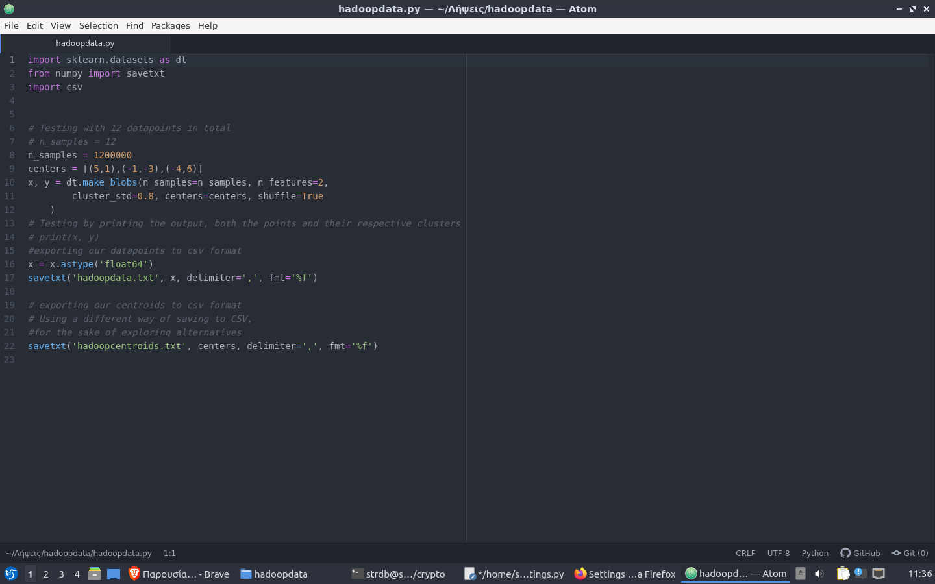
Data Creation
We create a sample of 1,2m data points, biased towards the three centers we provide. We set the centers to different quadrants, to give a better initial clustering. We do that with the help of sklearn library
We output both the data points and the centers to csv files. These processes are implemented in our “hadoopdata.py” python file

Slide 3
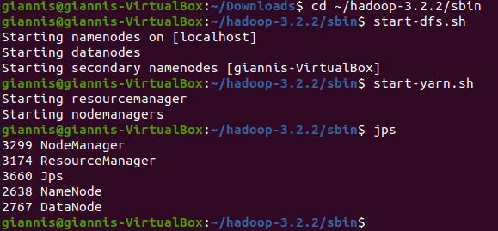
Start Hadoop daemons
We have installed hadoop and configured it to a pseudo-cluster mode.
We start our dfs and yarn daemons, so that we can run our job and manage our Hadoop resources and nodes

Slide 4
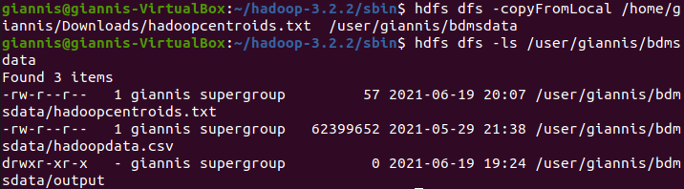
Load Data to hdfs
We load our data to hdfs, so that they are accessible to the mapreduce jobs we will create within Hadoop. We create the desired directory, and load our csv files, with the “copyFromLocal” command.

Slide 5
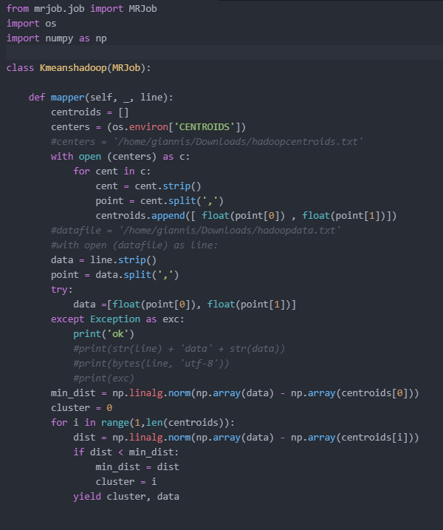
JMapping phase - mrjob
Firstly, we identify that our initial centroids are imported as environment variables, so as to be accessible to all mappers.
We get our data points, compare the euclidean distances from the centroids with the help of numpy, and yield pairs of clusters and our data points.

Slide 6
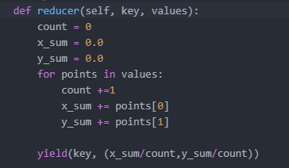
Reducing phase - mrjob
We only write the iteration for one key. Mrjob will repeat the function itself in the background for each key we have from the mapping phase.
We simply set a sum for x values, y values, and the number of datapoints. We yield for each cluster, the new centroids, as the quotient of the sums by the number of elements

Slide 7
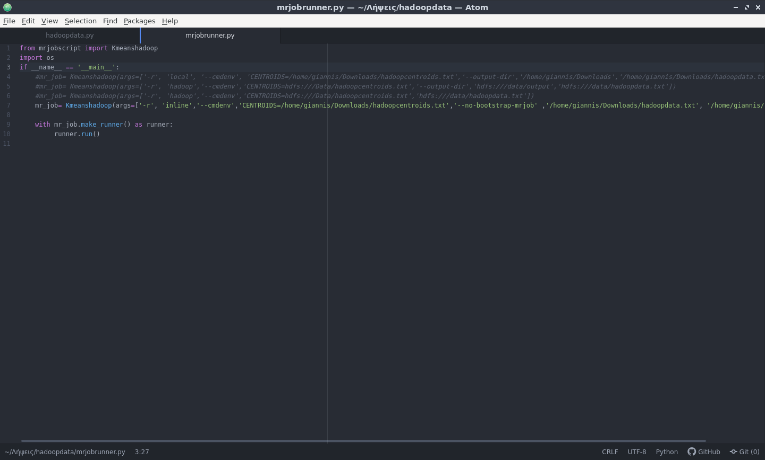
Job wrapper - mrjobrunner
We create a seperate python file, which allows us to programmatically run different implementations of the created jobs. With mrjob we can run our jobs inline (locally in a single thread), locally (locally with multi-thread, a mimic of a hadoop multi-cluster implementation), as well as with connection to an actual hadoop cluster.
For our local implementation we get our data from a local source, while for hadoop implementations, we get them from a relative hdfs path.

Slide 8
Local execution
Local and inline implementations of the script were successful, resulting in new centroid files - attached & reproducible. No config specified, means they are running on default configuration files (we could have defined our own config file, stating centroids there as global variables)

Slide 9
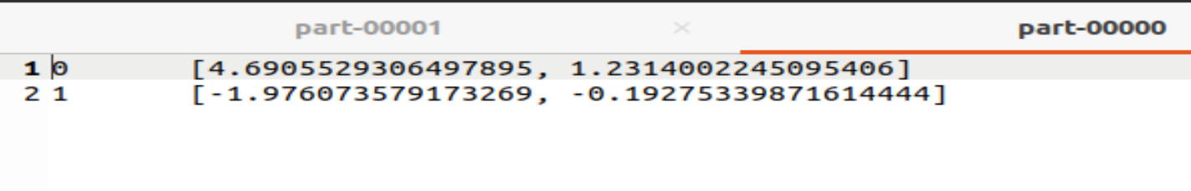
Local execution
They both create two files (better said, partitions). This is due to the data block size, and the number of workers (mappers - reducers) the job is put to during execution.
There is no issue with that, since we only implement one iteration of k-Means. However, we need to merge these files to provide them as the new input, were we intending to repeatedly run the job.
In local implementations, this could be done with local file manipulation.
During hadoop implementation, we would need to invoke the -getmerge command, which would merge the result files’ before making them locally available.(*)

Slide 10
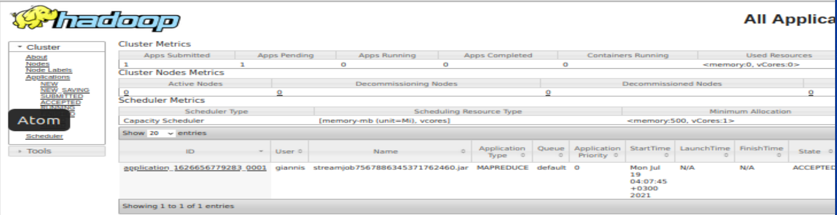
Hadoop execution
While the implementation of Hadoop in terms of code, seems to be no different, the script is not actually functional. The job is successfully imported in the system, but never executed, staying in the “accepted” state

Slide 11
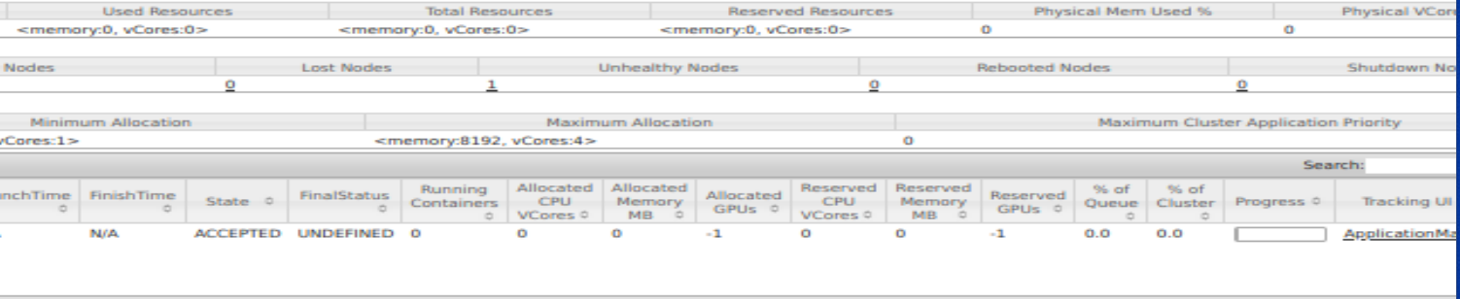
Troubleshooting
After searching about the incident, the issue seems to be that the resource manager does not recognize the resources given to the system, giving a total of 0 memory, and 0 vcores. As such, no resources can be allocated to the job

Slide 12
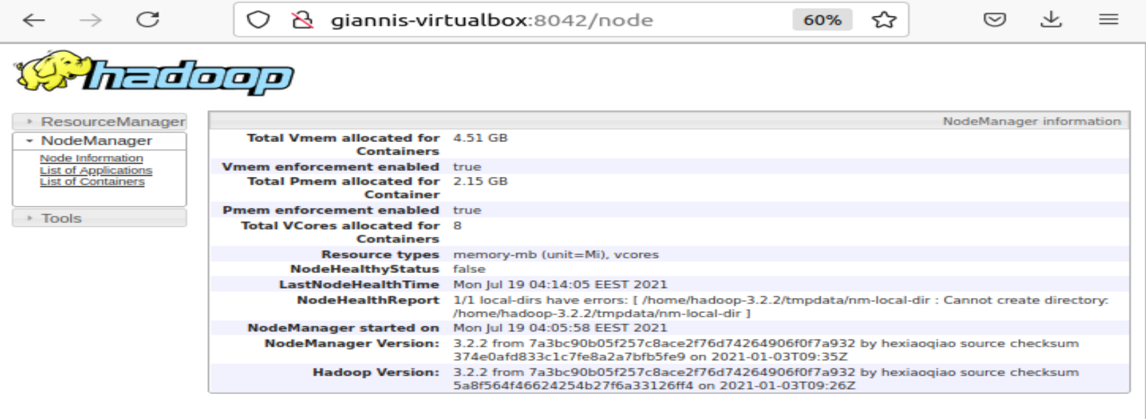
Troubleshooting
What is more interesting, is that browsing our node manager, the resources seem to be recognized. However, we see that no report can be created for nodehealth, due to a local directory fault.

Slide 13
Troubleshooting - Result
Given the fact that the two managers seem to have inter-connectivity issues, and server-to-local connection is not always successful, our best bet is that the local addresses in our configuration files (yarn-env, core-env etc. ) are not correct, resulting in such in such inconsistencies.
However, no matter the attempts, no correct configuration could be made, so that the resources were recognized and allocated to the job.

Slide 14
Get in touch with the code
The code is also publicly available to the following link

